Slide 1
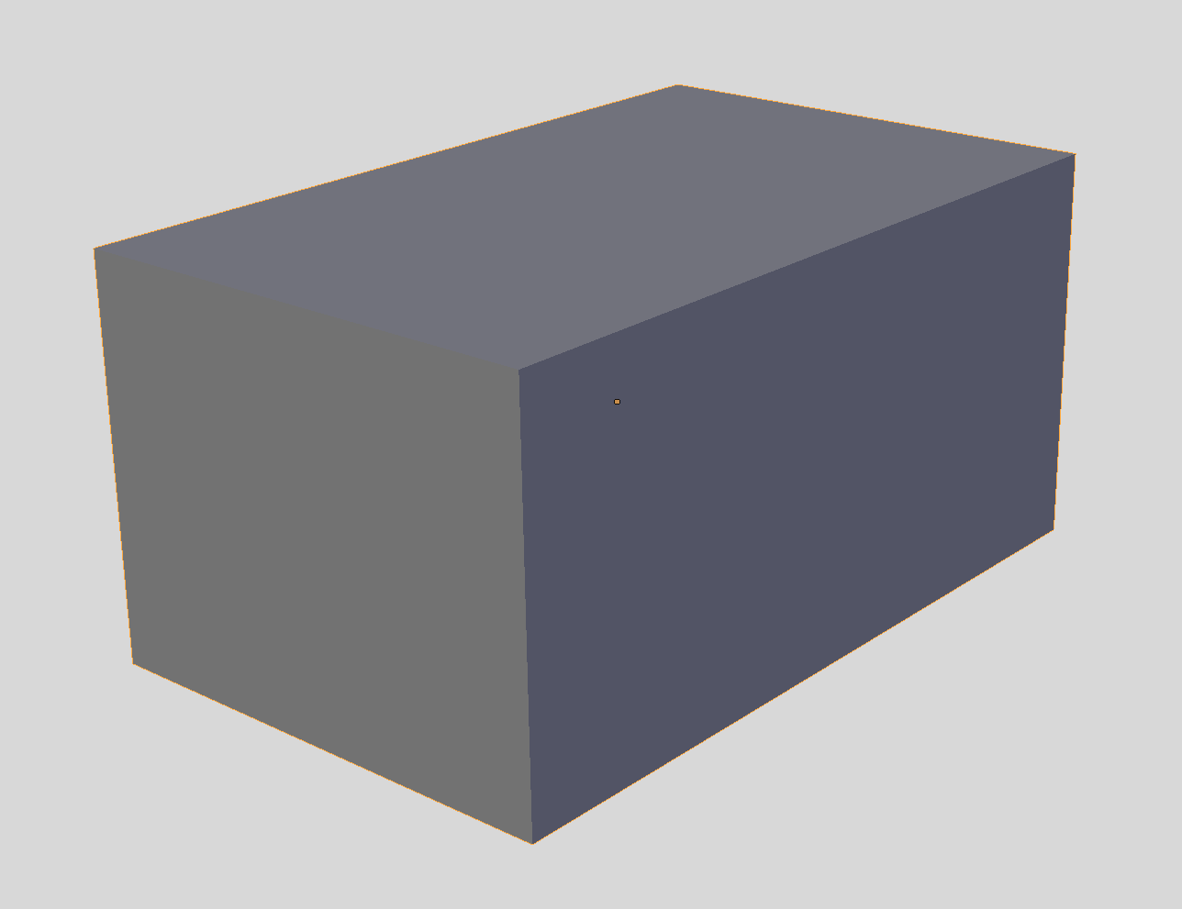
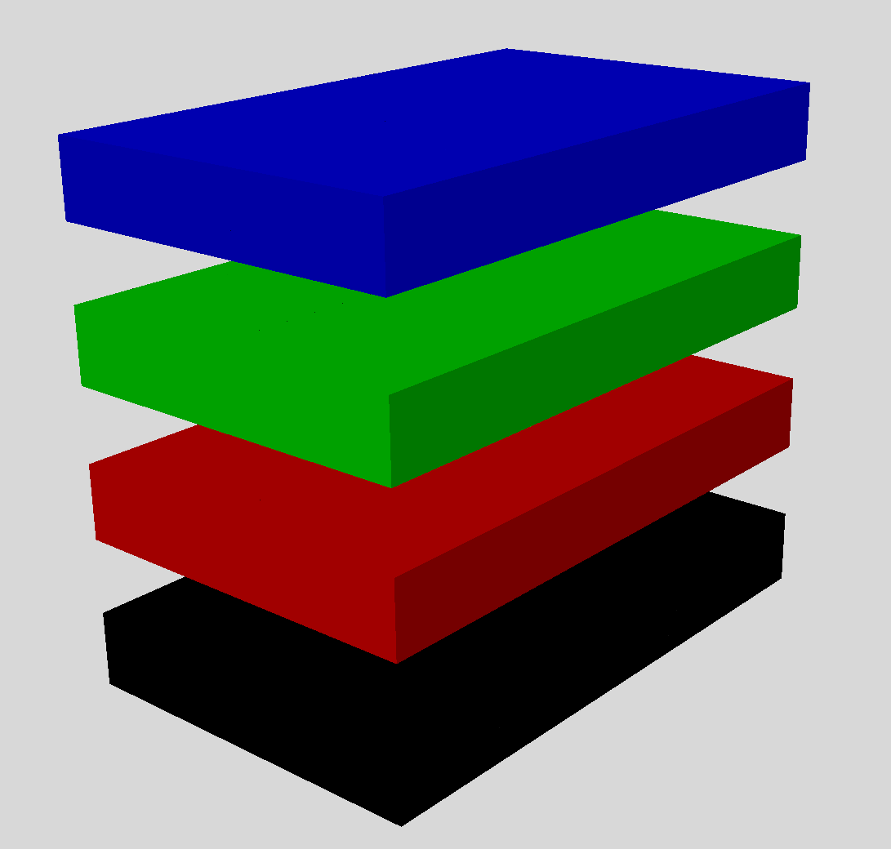
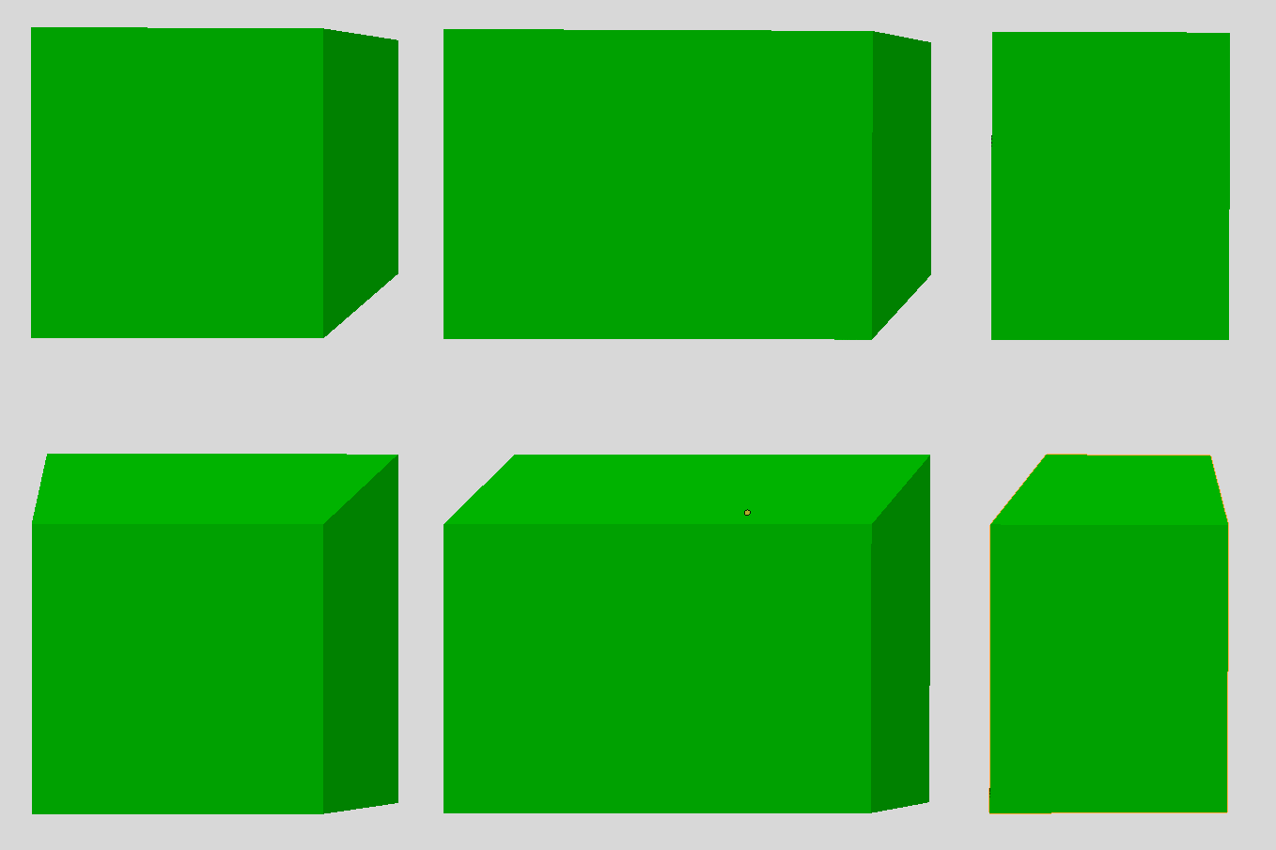
(A) Input STL Model of a Tall Box
(B) Z-Chunking of Tall Box into Four Jobs
0
1
Chunk 1
Chunk 3
Chunk 5
2
3
Chunk 0
4
5
Chunk 2
Chunk 4
(C) XY Chunking of One Job into Six Chunks
(D) Chunk Dependency Tree

